Slide 1
Basic Internship@Clevered AI App/ Project Name
App User Manual
Author: Baraa

Slide 2
Table of Contents
Acknowledgment
About me
My Intership

Slide 3
Acknowledgements
A small vote of thanks for all who have helped me in this journey of App Development – my parents, Mr Ken, Clevered, Mentors, Group Members, Friends, Miss.Mani, Sites etc.

Slide 4
About Me..
Student’s Introduction
Name: Baraa
Age:11
Hobbies: Coding, Football
Location:Lebanon,Jiyeh

Slide 5
About My Internship with Clevered..
Your internship experience with Clevered
Excellent, easy ,and wonderful
Badges Earned
Rockstar for Project Completion

Slide 6
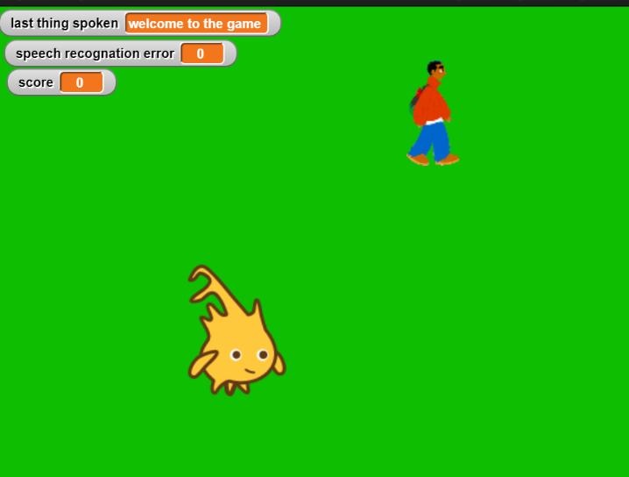
synthesis
About App..
App’s Main Menu
App’s Introduction
Adventure Game
Which uses Speech Recognation
And Speech synthesis to play

Slide 7
How do I use the App?
Click on the green flag to start the game
To move left say left and to move right say right to move up say up to move down say down and stop to stop the app

Slide 8
Option Name
(This will be repeated for each option of the App)
Internet Connection Must Be Good.
Mic should be proper/Good
Steps to use the same
Any special considerations/ dependencies/risks while using the option

Slide 9
Contact Person
Please reach out to student name at student’s email address for any questions/ concerns/ suggestions on the App
Name:Baraa
Email: Baraajouzou8@outlook.com

Slide 10
Thank you!

